Slide 1

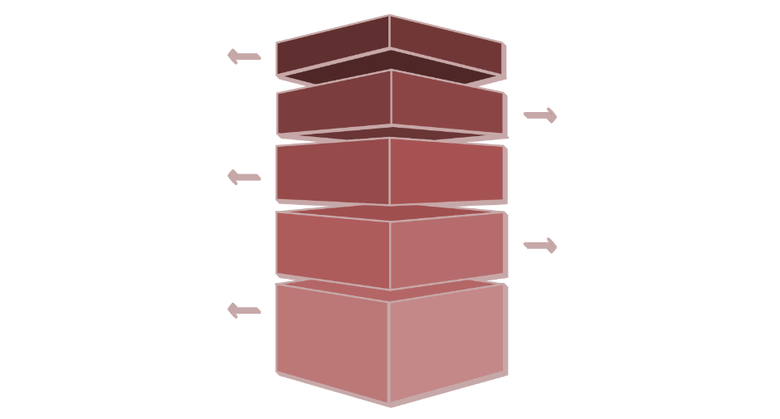

Customers, Retail & Transaction Analysis
Customer Insights
Collect demographics and behavior data.
Retail Footprint
Map store performance and locations.
Transaction Analysis
Analyze sales, basket size, and trends.
Segmentation
Create customer groups for targeting.
Actionable Strategy
Implement personalized campaigns and offers.
End-to-End Performance Review: Product, Data, Business & Financial Insights.

Slide 2











STRATEGIC OVERVIEW
Objective & How We Will Walk Through This Report
Business Task
Scope & KPIs
Walkthrough Approach
Consolidate customer, retail, and transaction data into a unified Power BI report to understand performance across products, channels, and geographic locations.
Track critical metrics including Unique Customers, Total Orders, Revenue, Discounts, Returns, Ratings, Issues, Resolution Time, and Satisfaction scores.
As your Product Manager, I'll guide you through each visual, connecting insights to actionable decisions for our market, company, teams, and clients.
Ultimate Goal
Transform this dashboard into a decision engine that reveals where we're winning, where we're leaking value, and which levers deliver the fastest uplift.

Slide 3







KPIS
Executive KPIs – The Story in One Glance
5,000
4,610
Unique Customers
Total Orders
Solid active base to grow from
Strong engagement and repeat behavior
4.02
27M
Avg Product Rating
Net Revenue
Positive experience with improvement pockets
After discounts and returns
Revenue Bridge Insight
List Revenue: $54,009K → Discounts: -$157K → Returns: -$6K → Net Revenue: $27,005K
We have an engaged customer base and healthy topline, but we're leaking measurable value through discounts and returns. This gives us direct product, pricing, and service levers to improve profitability while protecting customer experience.

Slide 4


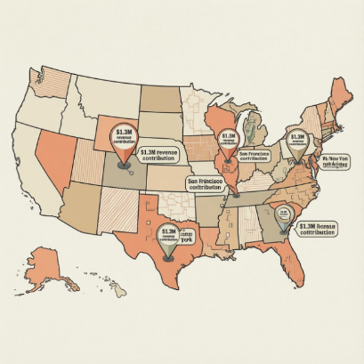

CHANNEL ANALYSIS
Where Our Revenue Comes From – Channel & Geography
Online-First Model Confirmed
Online channels generate approximately $13.78M, significantly outperforming any single physical city location. Major cities like Houston, Chicago, San Francisco, Los Angeles, and New York each contribute around $1.3M.
This confirms digital is not a support channel. Online platforms should lead our experimentation, personalization, and UX investments.
Growth Trajectory
Revenue from 2021–2025 ramps from near-zero to high six- and seven-figure values, demonstrating strong growth and platform scalability.
PM Priority: Focus on the online journey from discovery to checkout and post-purchase, then fine-tune by location to align marketing and inventory with high-performing regions.

Slide 5





PRODUCT EXCELLENCE
Hero Products, Key Customers & Customer Experience
Furniture Leaders
Electronics Portfolio
VIP Customer Cohort
Bed Frame, Office Desk, Sofa, Bookshelf, and Dining Table each contribute $0.89M–$1.37M in revenue.
Xiaomi Mi 12, OnePlus 10, iPhone 13, Google Pixel 6, and HP Spectre drive substantial revenue across categories.
Top 10 customers generate $872,420 in net revenue with 522 items – a highly profitable segment deserving loyalty programs and premium support.
Category Performance Snapshot
High Performers
Improvement Opportunities
Tablets: 4.47 average rating
Categories like Smartphones, Furniture, and Kitchen Appliances show higher counts of low ratings, pointing to content, quality, or expectation gaps.
Desktop Computers: 4.16 average rating
TVs: 4.16 average rating
Most categories maintain ratings at or above 4.0, signaling strong overall experience.
Strategy: Double down on hero products and top customers while systematically improving weaker categories using detailed feedback and returns data.

Slide 6



MARGIN PROTECTION
Discounts, Returns, Issues & Resolution – Impact on Profit & Experience
Discount Impact
Returns Leakage
Service Issues
High-revenue categories like Furniture, Smartphones, Laptops, and TVs show average discounts around 5–5.5%, meaningfully impacting margin.
The revenue bridge shows how discounts and returns reduce list revenue to net – making it easy to quantify financial impact and set guardrails.
Issues cluster around Shipping, Returns, and service categories, with some reaching 210–212 tickets across High, Medium, and Low priority levels.
Resolution & Satisfaction Correlation
41.45
Data shows that faster, clearer resolution directly correlates with higher satisfaction scores over time.
Strategic Lever: Treat discounts, returns, and service issues as controllable levers. Refine pricing strategy, tighten quality expectations, and redesign support flows to protect margin and improve loyalty.
Avg Resolution Time
Hours to resolve – long relative to expectations

Slide 7

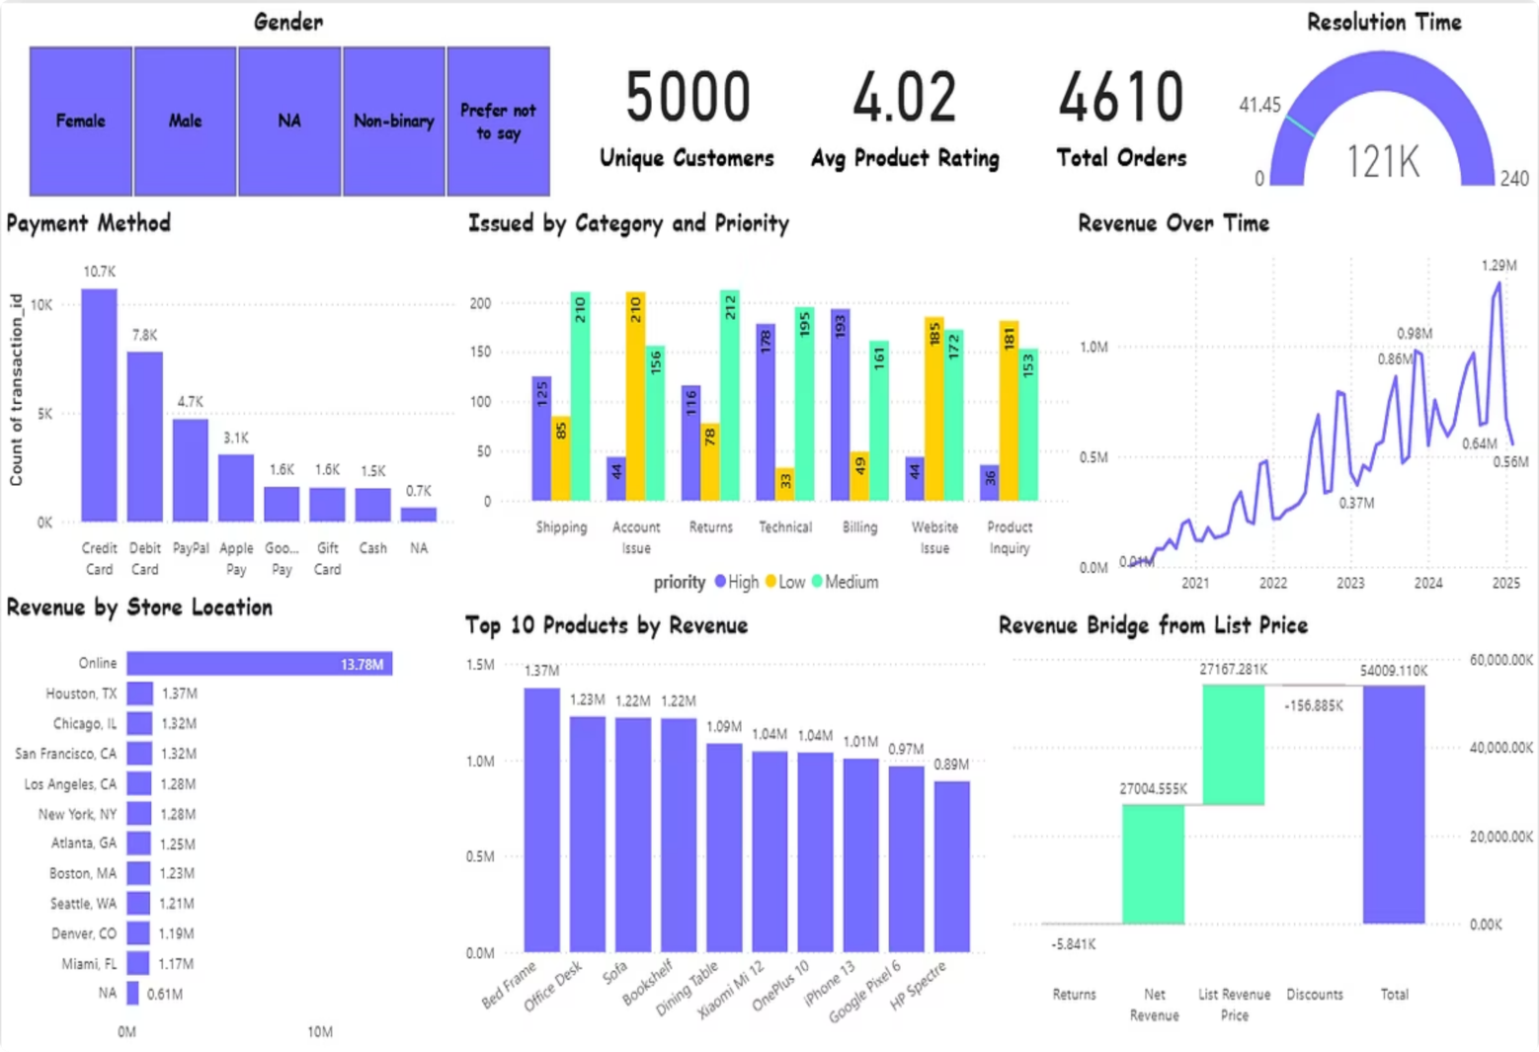

KEY INSIGHTS
Executive Dashboard Insights
Gender Distribution→ The customer base is broadly distributed, indicating mass-market reach.
Resolution Time (121K)→ Resolution time is high, impacting customer experience.
Payment Method→ Credit and debit cards dominate, confirming strong digital adoption and low payment friction.
Issues by Category & Priority→ Shipping and returns drive most issues, highlighting process gaps rather than product flaws.
Revenue Over Time→ Revenue shows consistent upward growth with volatility, indicating scale with execution risk.
Revenue by Store Location→ Online channels overwhelmingly outperforms physical stores, making digital the primary growth driver.
Top 10 Products by Revenue→ A small set of products drives most revenue, creating both focus and concentration risk.
Revenue Bridge from List Price→ Discounts and returns significantly erode revenue, emphasizing the need for pricing discipline.
Notes:
This slide features a visual representation of the key concept we've been discussing. The image on the left provides a clear illustration of the process or system we're explaining. On the right, we have some supporting text that helps reinforce the main points. I'd recommend highlighting a few of the key details called out in the image and relating them back to the overall topic. This visual should help make the content more engaging and easier for the audience to understand. Feel free to point out any particularly noteworthy or insightful elements of the image as you walk through this part of the presentation.

Slide 8

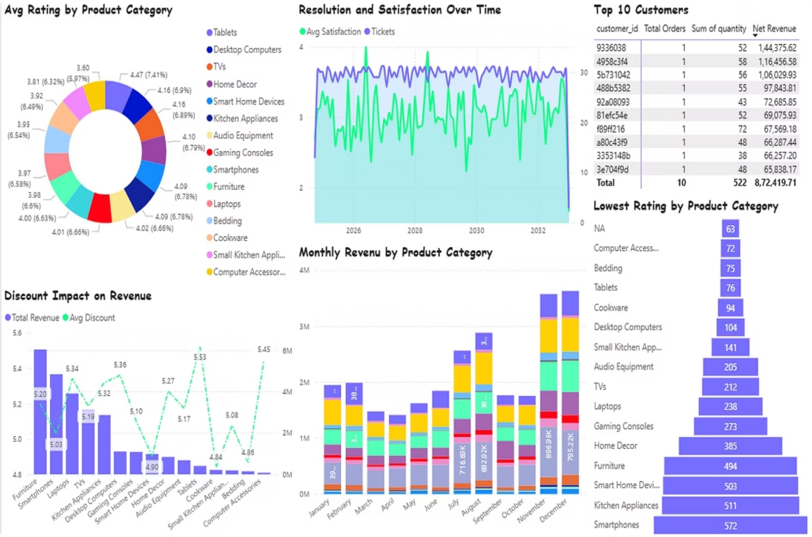

KEY INSIGHTS
Executive Dashboard Insights
Average Rating by Product Category→ Ratings are clustered around 4, but variation suggests uneven experience quality across categories.
Resolution & Satisfaction Over Time→ Satisfaction fluctuates despite stable ticket volume, implying resolution quality matters more than speed.
Top 10 Customers→ A few customers contribute disproportionately to revenue, increasing dependency risk.
Lowest Rating by Product Category→ High-revenue categories also appear in low-rating counts, signaling hidden retention risk.
Discount Impact on Revenue→ Higher discounts do not consistently drive higher revenue, indicating inefficient discounting.
Monthly Revenue by Product Category→ Strong seasonality with Q3–Q4 peaks, critical for inventory and campaign planning.

Slide 9





PRODUCT MANAGER
Product Manager Perspective – Journey & Uplift
Priority: Post-Purchase
Focus on "receive" and "support" steps first. Shipping and returns issues, combined with long resolution times, show clear friction hurting satisfaction and creating avoidable costs.
Fast Impact Path
Target Online channel and high-revenue categories like Smartphones and Furniture. They drive large volumes – improving ratings and reducing returns unlocks substantial incremental revenue.
Roadmap Framework
Target the highest-friction, highest-impact parts of the journey first, then scale wins across channels and categories. This approach delivers visible improvements to both customer happiness and margin with measurable ROI.

Slide 10

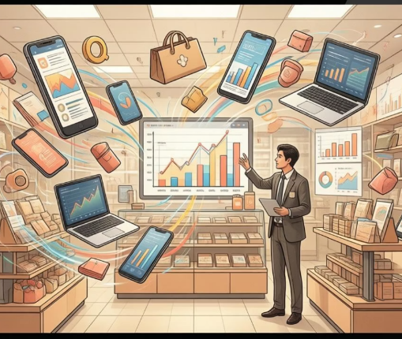

PERSPECTIVE
Analyst Perspective – Depth & Quality
Additional Data Needs
Data - Depth & Quality Gaps
Missing Values
Inconsistent Categories
Areas with many "NA" values (e.g., gender) indicate incomplete data capture that limits segmentation capabilities.
Issue categorization lacks standardization, making trend analysis difficult and reducing the reliability of insights.
Need for Dimensions
Adding standardized dimensions for customer segments, product sub-types, and support channels will sharpen analysis and enable more reliable segmentation.
Business - Growth & Profitability
Growth Quality
Expansion Focus
To deepen insights, we should integrate:
Discounts boost short-term revenue, but sustained discounting and returns dilute long-term profitability.
High-revenue, well-rated products, top cities, and high-value customers offer the most scalable growth.
Cohort retention by acquisition month
Strategic Alignment
Funnel drop-offs from browse → cart → purchase
Customer lifetime value metrics
Growth decisions must balance volume, margin, and customer experience.
Device type, campaign source, and referral channel data
Financial - Margin and Impact
These dimensions will reveal which acquisition paths produce our best customers and where we lose potential value.
Margin Leakage
Efficiency Levers
Foundation for Success: This perspective ensures every decision on the product and business side is grounded in reliable, well-structured data that drives confident action.
Discounts and returns are the primary sources of margin erosion across the revenue bridge.
Higher ratings and faster resolutions drive repeat purchases while lowering support costs.
Unit Economics
Pricing discipline and experience improvements enable more capital-efficient growth.

Slide 11


END
Conclusion
•As a product manager, I approached this report by integrating four perspectives into a single, coherent story:
Product Manager Perspective
Analyzed from the customer journey and used the dashboard to identify where experience breaks and where uplift is fastest, prioritizing the post-purchase and online flows.
Data Analyst Perspective
Emphasize data quality, identifying missing values, inconsistencies, and the need for new dimensions to enable comprehensive segmentation and reliable insights.
Business Analyst Perspective
Analyze growth opportunities, segment analysis, and profitability, ensuring decisions balance volume, margin, and customer experience.
Financial Analyst Perspective
Concentrate on margin protection, unit economics, and financial discipline, evaluating how discounts and efficiencies impact long-term profitability.
Thank you for your time and consideration of this analysis.

